Slide 1



Database Project- Shani&Ori Cinema
Made by: Ori Katz - 314632449 Shani halali – 211523261

Slide 2

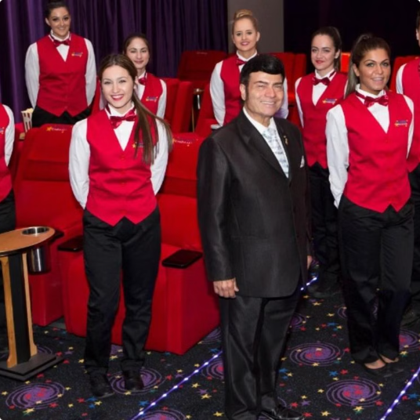


Target Users
Management
Cinema Staff
Viewers

Slide 3

Introduction
This project is a cinema management system designed to improve the efficiency of cinema operations. It enables the cinema manager, employees, and viewers to access important information and perform essential tasks.
system tools The system includes tools for managing movie screenings, ticket sales, employee scheduling, and viewer data.
convenience view It provides the manager with a clear overview of profits, employee performance, and movie success, while also allowing employees and viewers to interact smoothly with the cinema.

Slide 4
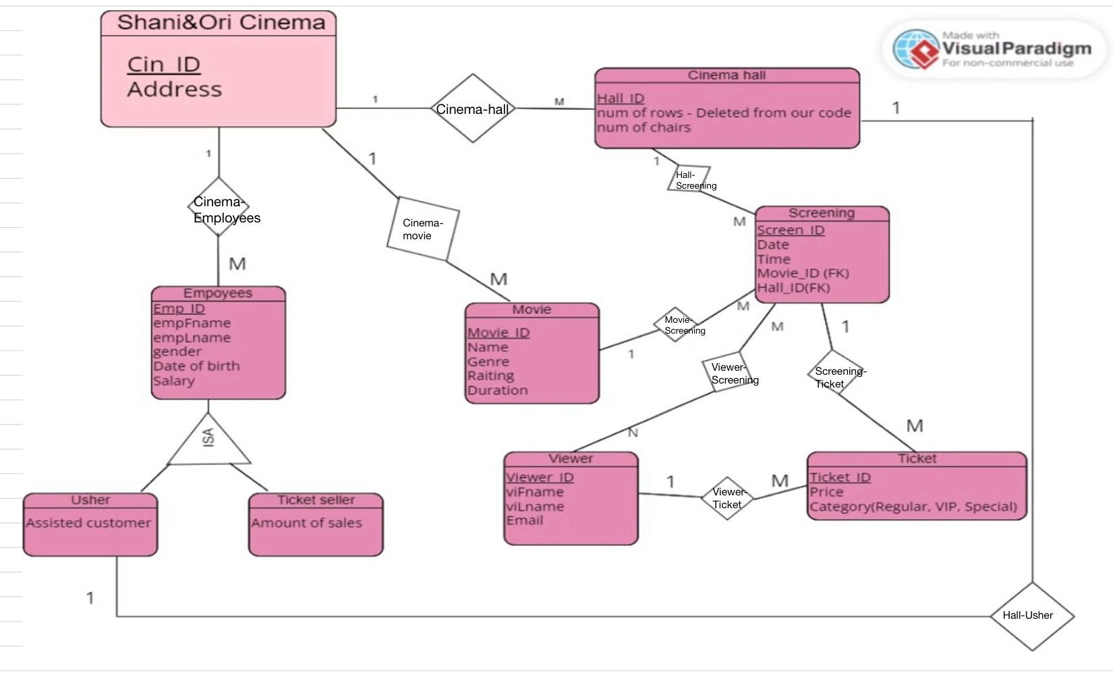
ERD

Slide 5
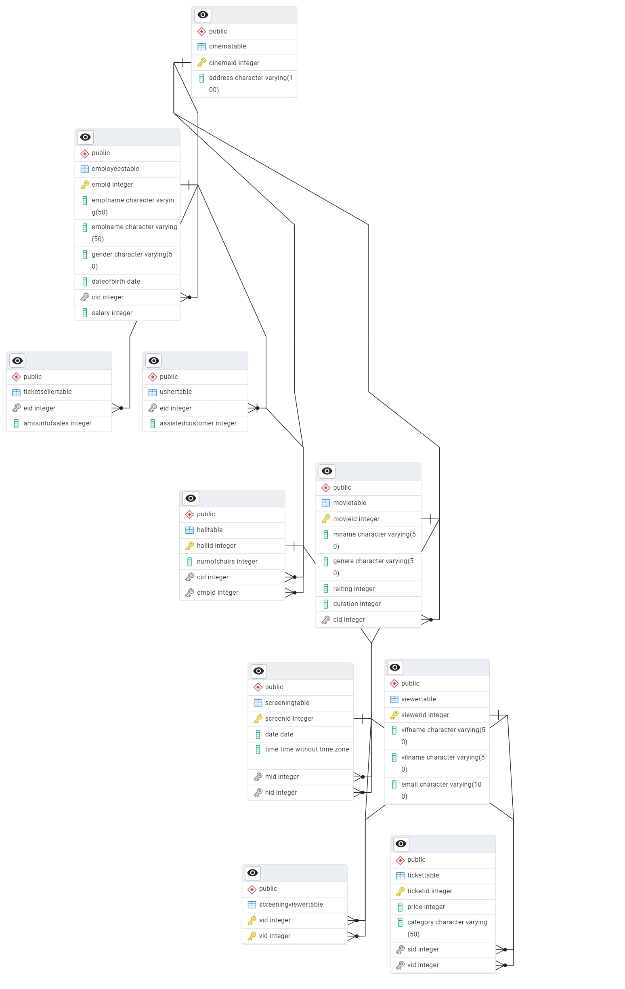

Slide 6
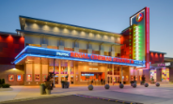
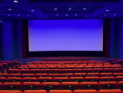




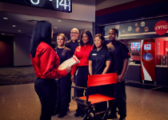
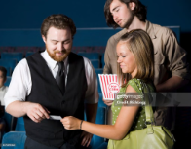
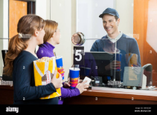
Entities
The Shani&Ori Cinema database contains multiple entities that represent different aspects of the cinema's operations.
Cinema
Halls
Movies
Screenings
Viewers
Tickets
Employees
Ushers
Ticket Sellers

Slide 7
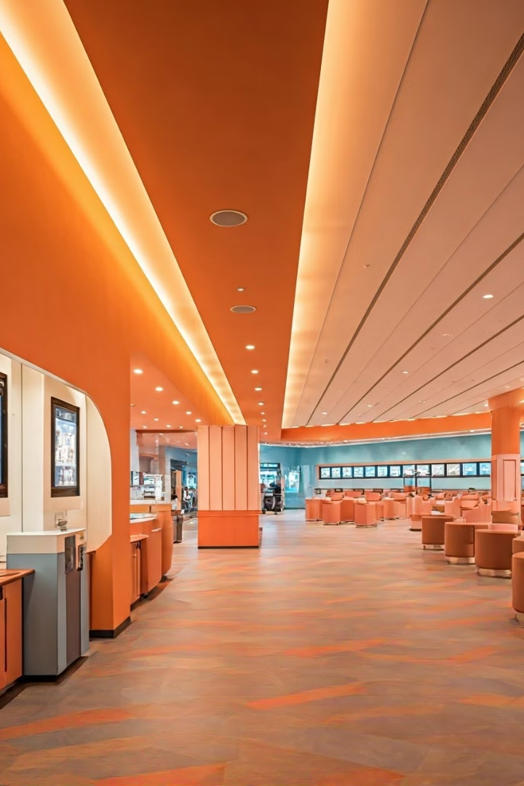
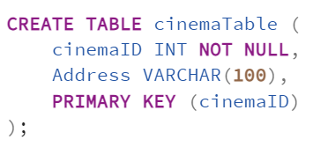
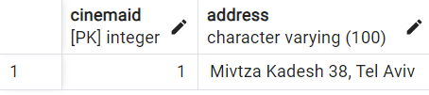
Cinema
Cinema attributes:
Cinema ID
Address

Slide 8

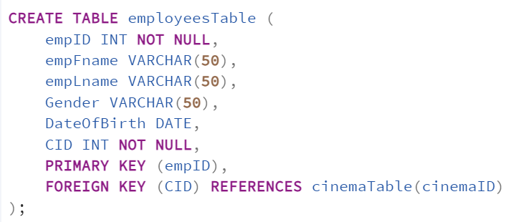
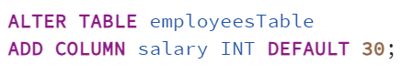
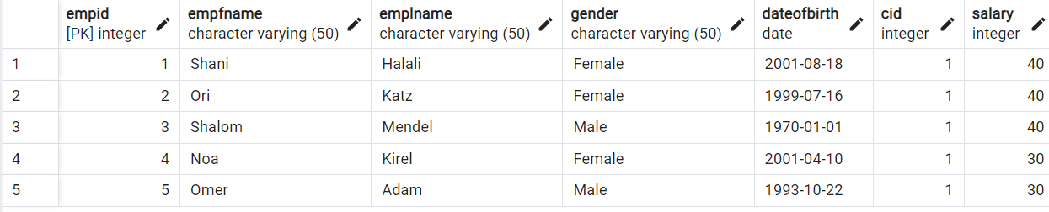
Employees
Employees attributes:
Employee ID
Cinema ID
First Name
Last Name
Gender
Date Of Birth
Salary

Slide 9

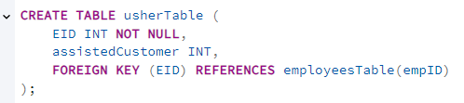
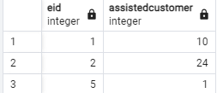
Usher
Usher attributes:
Usher ID
Assisted Customer

Slide 10
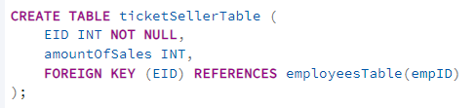
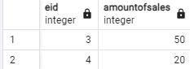
Ticket Seller
Ticket Seller attributes:
Ticket Seller ID
Amount Of Sales

Slide 11
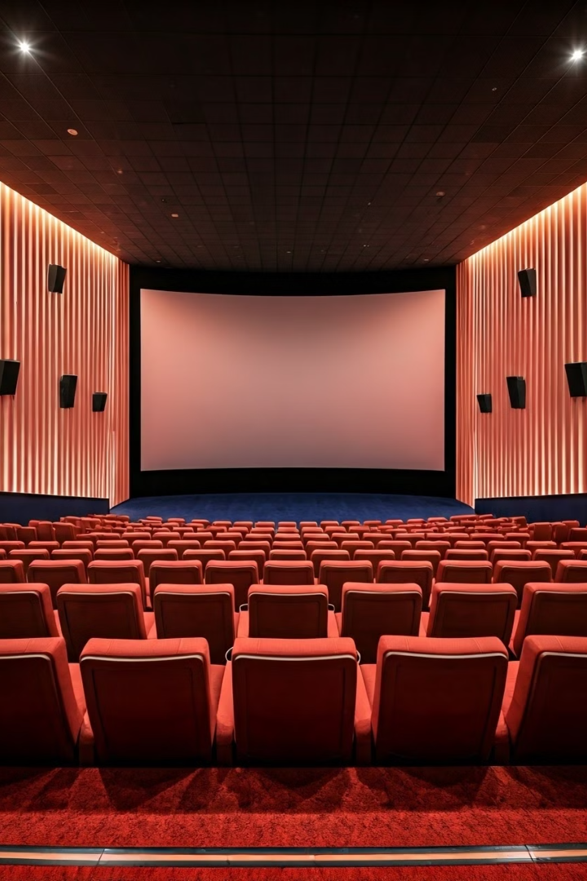
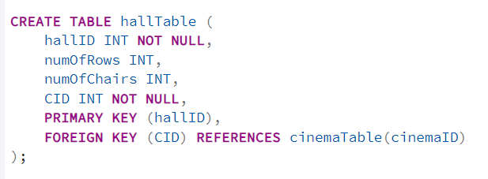
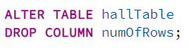
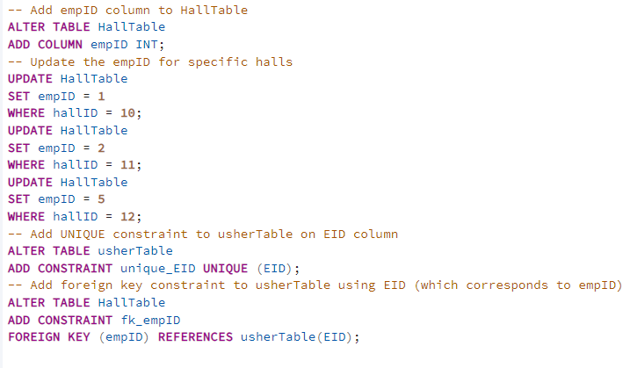
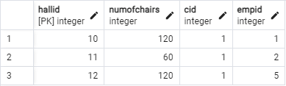
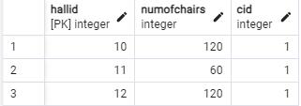
Halls
Halls attributes:
Hall ID
Num Of Chairs
Cinema ID
Employees ID

Slide 12
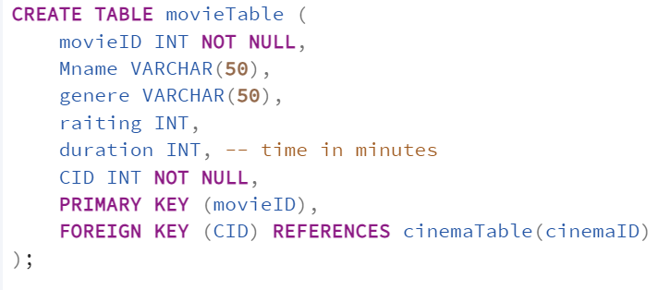
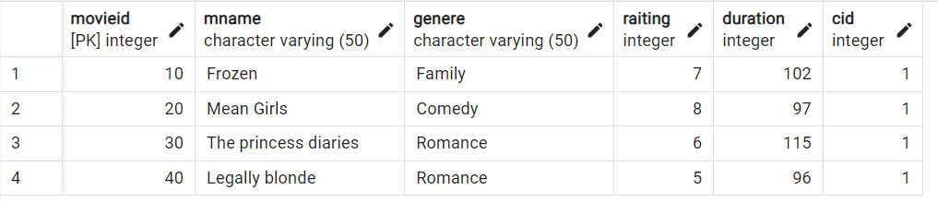
Movies
Movies attributes:
-Movie ID
-Cinema ID
-Name
-Genere
-Rating
-Duration
)

Slide 13
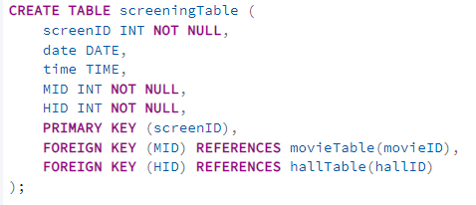
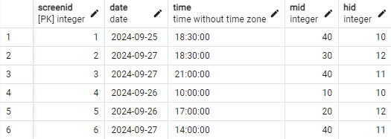
Screening
Screening attributes:
Screening ID
Date
Time

Slide 14
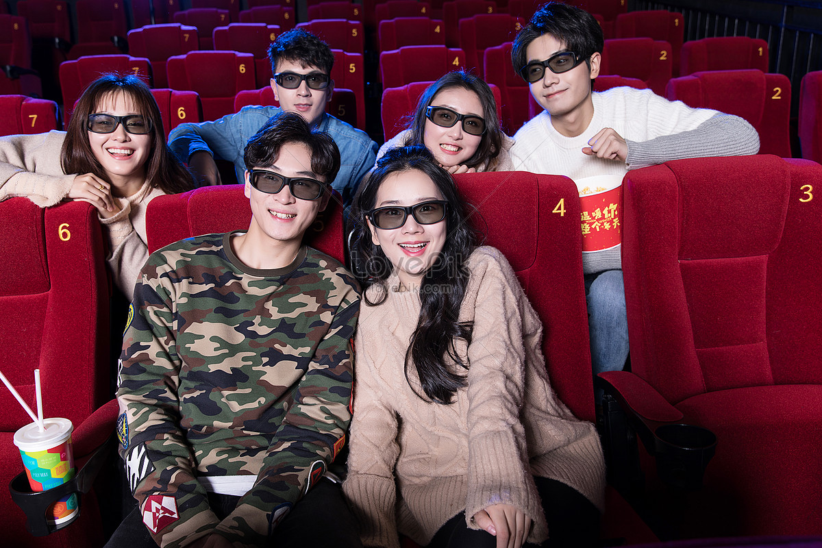
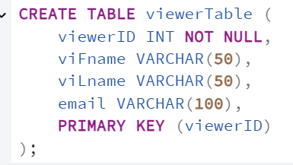
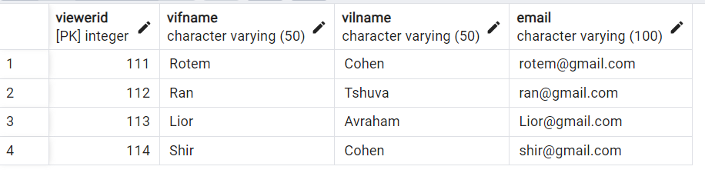
Viewers
Viewers attributes:
Viewer ID
First Name
Last Name
Email

Slide 15
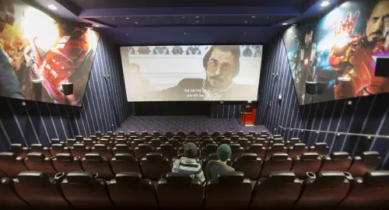
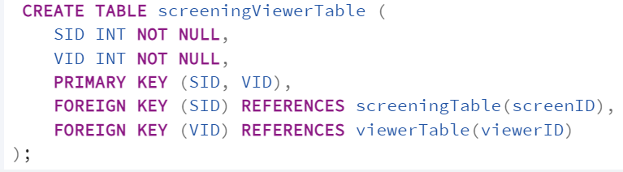
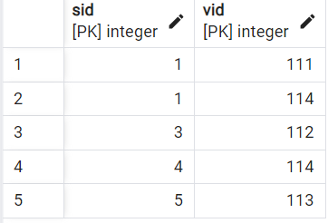
screening Viewer
Screening viewers attributes:
Screen ID
Viewer ID

Slide 16
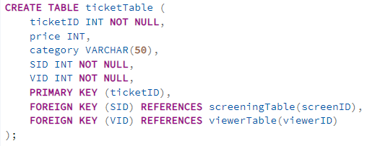
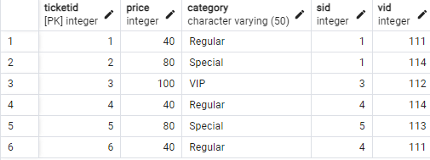
Ticket
Ticket attributes:
Ticket ID
Price
Category
(Regular 40₪,VIP 100₪,Special 80₪)

Slide 17
System actions designed for the manager

Slide 18

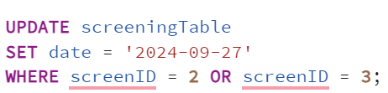
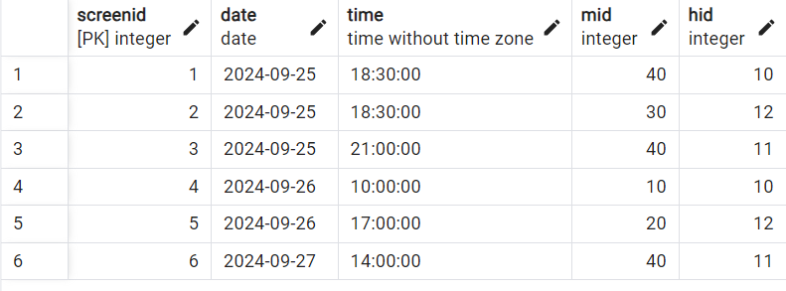
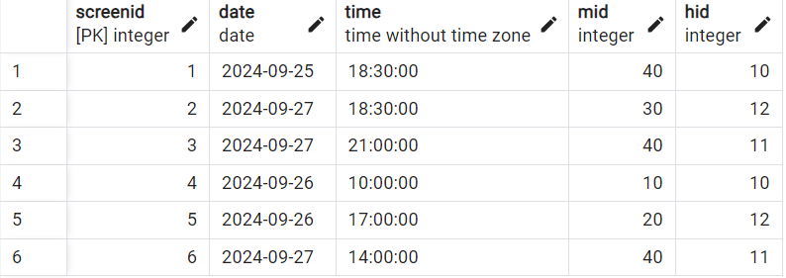
The manager has the ability to modify screening dates. We wrote an example query that updates the dates of two screenings.
Before
After

Slide 19
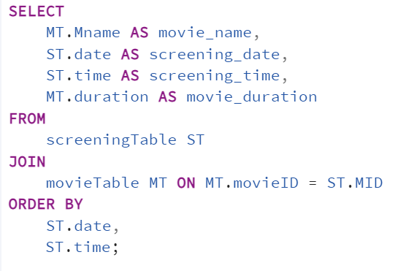
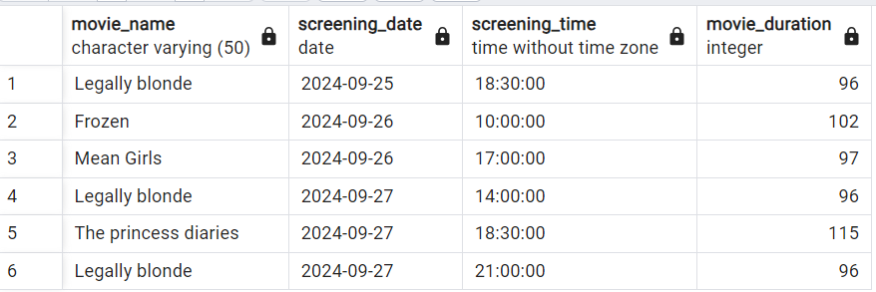
We created a query that sorts all cinema screenings by date and time aiming to present the screenings in an accessible and organized manner.
The resulting table displays the movie title for each screening, the screening date, time, and the duration of the movie.

Slide 20
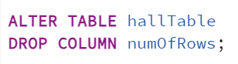
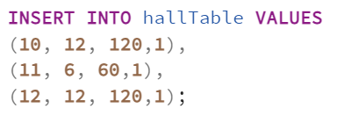
We executed a query that deletes the column for the number of rows in the hall.
we decided to remove it because the number of seats includes the total chairs in the hall.
This change reflects a revision of our initial design since we no longer needed this data.
At first, we entered the number of rows and the number of seats in each hall, but we defined the number of seats in a hall to be 10 times the number of rows.
This way, the number of seats includes the total number of seats in the hall, and there is no need for the number of rows
12*10=120

Slide 21
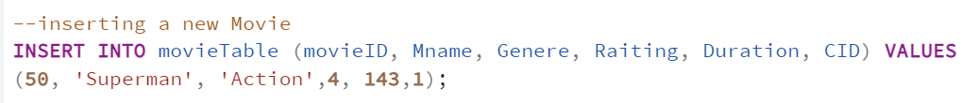

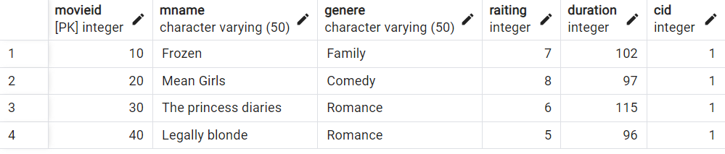
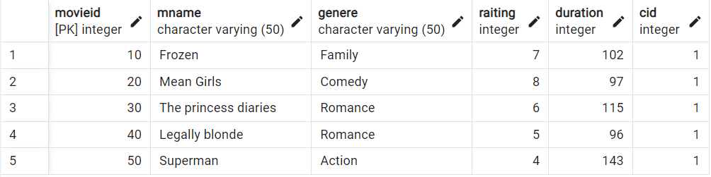
We added an INSERT query to add a new movie to the cinema.
Movie Table
Before
After

Slide 22
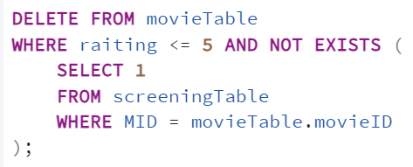
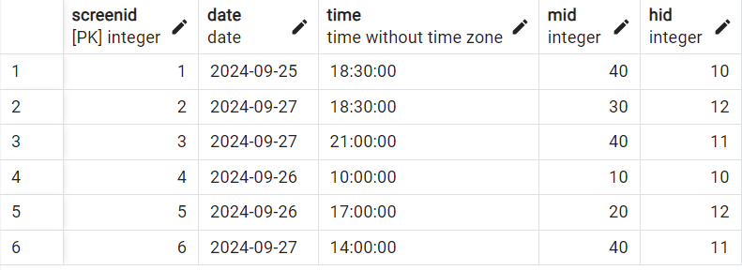
We implemented a query that deletes movies with a rating of 5 or below, as the cinema does not wish to retain less popular films.
Movies with a rating of 5 or below.
However, if a movie has already scheduled screenings, it will not be deleted to avoid impacting viewers who have purchased tickets.
After executing the query
Movie 40 is not deleted despite its rating of 5 because it has screenings

Slide 23
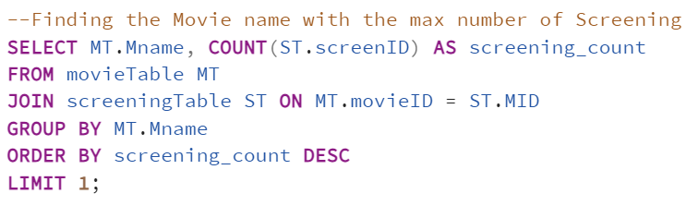
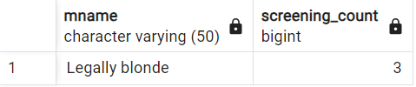
query that finds the movie with the maximum number of screenings

Slide 24



We added a query that calculates the cinema's revenue from ticket sales, so the manager can track the income
Ticket Table
40+80+100+40+80+40=380

Slide 25



We introduced a query that includes an aggregate and nested function to calculate the average number of viewers and revenue for each movie.
It will only display movies where the average number of viewers per screening exceeds 20.
We don't have data in this table at the moment because we don't have many viewers in the cinema yet
For the sake of the example, we'll display the movies where the average number of viewers per screening exceeds 1 instead of movies where the average exceeds 20.
This query is intended to allow the manager to monitor which movies are attracting larger audiences and the average revenue generated by each of them

Slide 26


We added a column to the employees table containing the salary per hour for each employee.
We decided to include this field after the initial design of the cinema.
We decided that the average hourly wage is 30, but if the employee's performance is good, it will increase (as we will see later).

Slide 27



We added a query that provides a bonus to the salary of outstanding employees, granting a bonus of 10 shekels to the hourly Salary of each employee.
An outstanding employee is defined as:
A ticket seller who has sold more than 30 tickets,
or
An usher who has assisted at least 10 people.
Usher Table
Ticket Seller Table

Slide 28

Employees Table
Before
After

Slide 29

We created a function named "check_movie_screenings" designed to verify if a specific movie has already had two screenings on the same date; if so, it raises an exception.
In other words, a movie cannot be screened more than twice in a day.

Slide 30


We defined a trigger named "before_screening_insert" that activates this function before any new screening is added to the screeningTable.
It can be seen that movie number 40 is being shown twice on 27/09
Therefore, if we try to add another screening of this movie on the same day
an error will appear.

Slide 31

System actions designed for the employees

Slide 32


We added two new employees using the INSERT statement and assigned them roles,
Noa as Usher and Omer as a Ticket Seller.
Employees Table
Usher Table
Ticket Seller Table

Slide 33

We created the employees_view, to provide information to the employees about their colleagues at the cinema, but only the information they allow to access,
without revealing salaries sensitive data such as salaries
The information displayed to employees includes the
*employee ID *employee name *gender *date of birth *role at the cinema

Slide 34

We created usherForHall_view that conveniently displays the list of halls along with the name of the usher assigned to each one.

Slide 35

We created a view usherScreening_view that conveniently displays the ushers work shift.

Slide 36

System actions designed for the viewers

Slide 37

We wrote the function "check_availability" to ensure that,
before purchasing a new ticket, we verify whether there is availability and a free seat for the specific screening the viewer wishes to buy a ticket for.
The availability is checked based on the number of seats in the hall where the screening takes place.

Slide 38

Additionally, we created a trigger that checks seat availability before each new ticket purchase by verifying the seat availability in the screening hall using the "check_availability" function we created.

Slide 39


We added an INSERT query to purchase a new ticket for a screening.
Ticket Table
Before
After

Slide 40


We added a query calculate the total expenses for ticket purchases made by the viewer “Rotem Cohen” at the Cinema
Viewer Table
Ticket Table

Slide 41

We created the MovieScreening_view
that allows for the viewers a convenient display of the movies being screened,
organized by movie name, including the screening date, time, and the number of available seats,
calculated as the total number of chairs in the hall minus the number of tickets already sold.

Slide 42

Thank you for watching

